Slide 1
Movie Review Model: Endgame
By: Aarshika, Angus and Ronak

Slide 2
Project Description

Slide 3

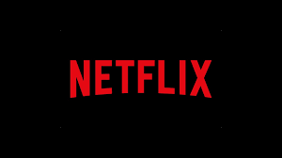
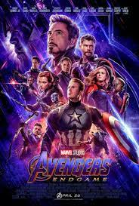

Problem Statement
Idea
Movies are not liked by everyone, some people like it and others don’t, so let's analyze the movie reviews to find out what people feel about it.
The idea behind this project is to give people recommendations based on the movies they watch and reviews of the people who have watched that particular movie.
Criticizers and supporters of the marvel fan base input their reviews about the movie.
The problem we are trying to solve is to see or view the percentage of people who liked or didn’t like the film and test
the machine to see how accurate it is.

Slide 4
Data Description

Slide 5

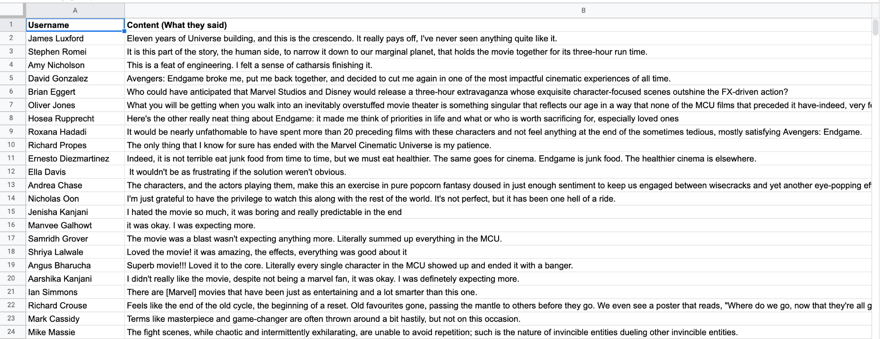

Our Data set consists of:
Username
Content
Score (out of 3)
Gender(1= Female, 2= Male, 3= Rather not say)
Date
Why is Gender important?
Gender is important because it depends on the viewer or the movie, for example, boys might prefer marvel movies more than girls as it involves
things that come to their liking, this can affect the data because there might be more guys who prefer the movie over girls.
Why is the date important?
The date is important as it gives an idea of when the person has watched the movie either at the time of the release
or a few months or years down the line. It would show the interest of the person and how engrossed he or she is in the movie.

Slide 6
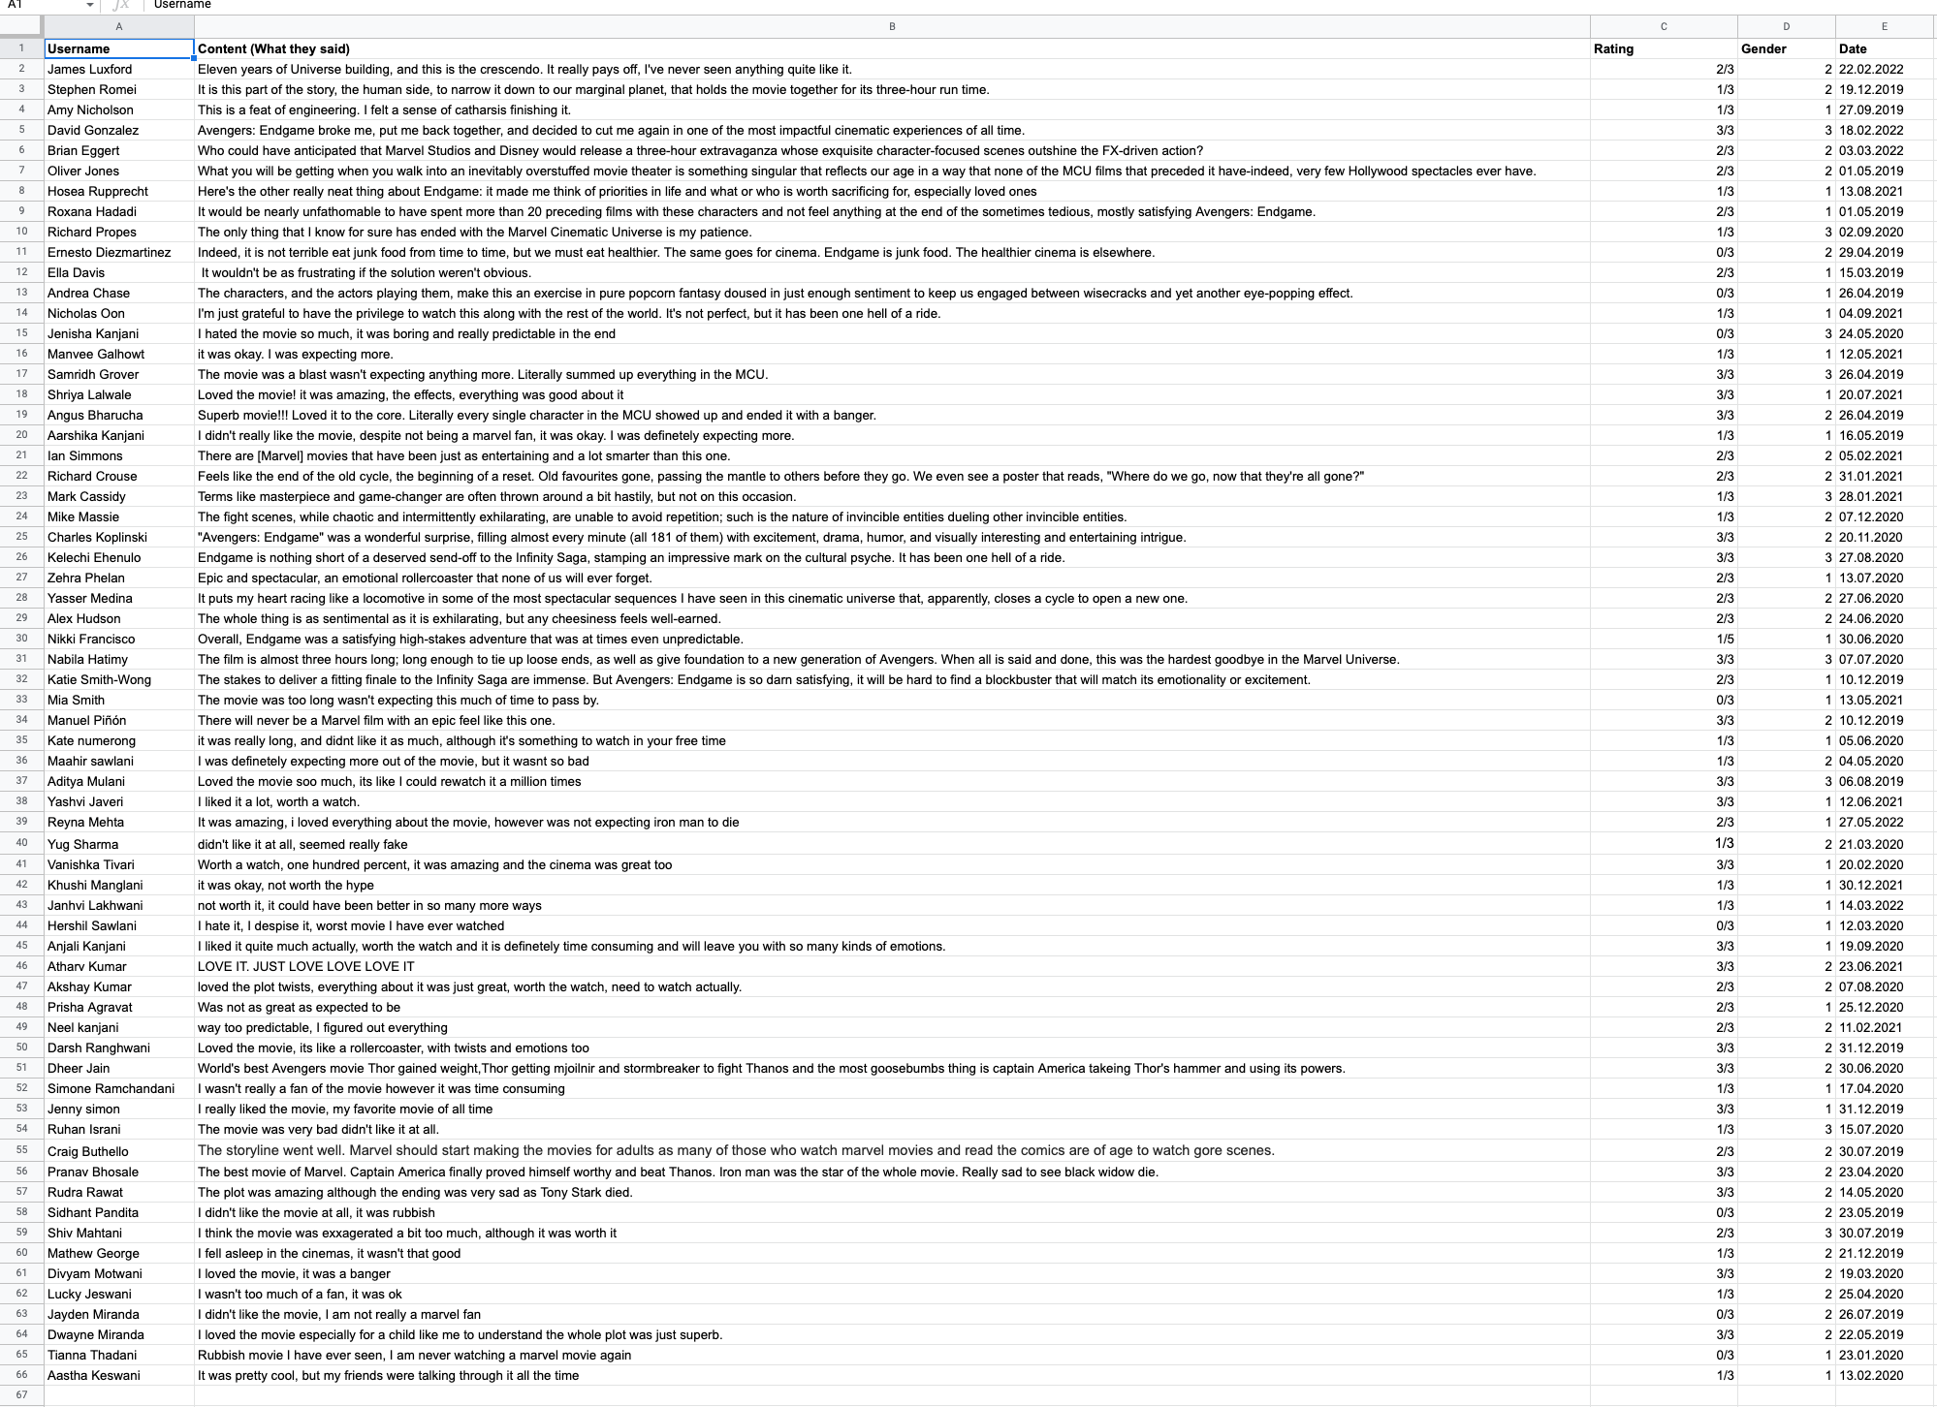
Data shared: training and test
A greater look of the data

Slide 7
Methodology

Slide 8
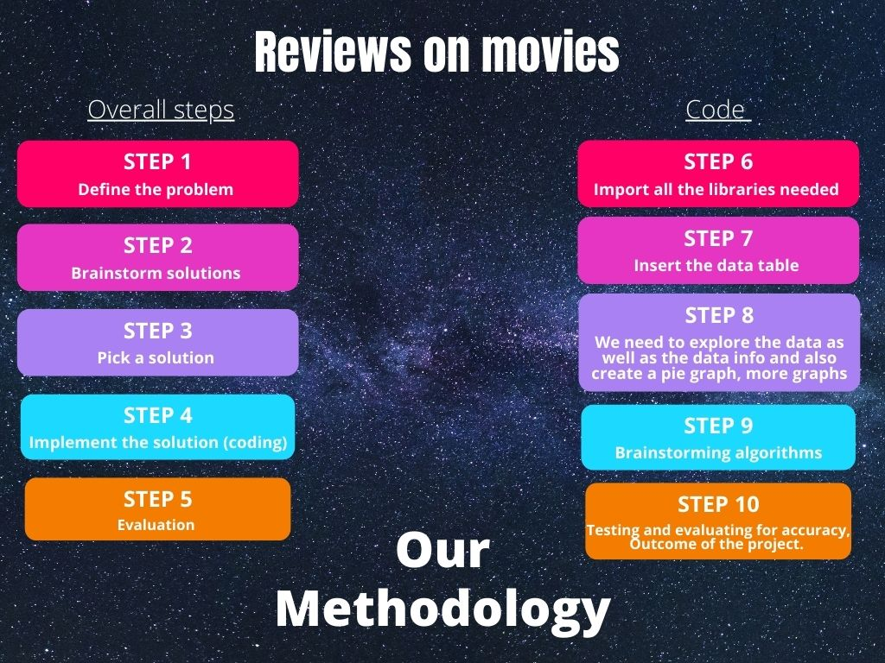

Slide 9
Visual Graphics

Slide 10
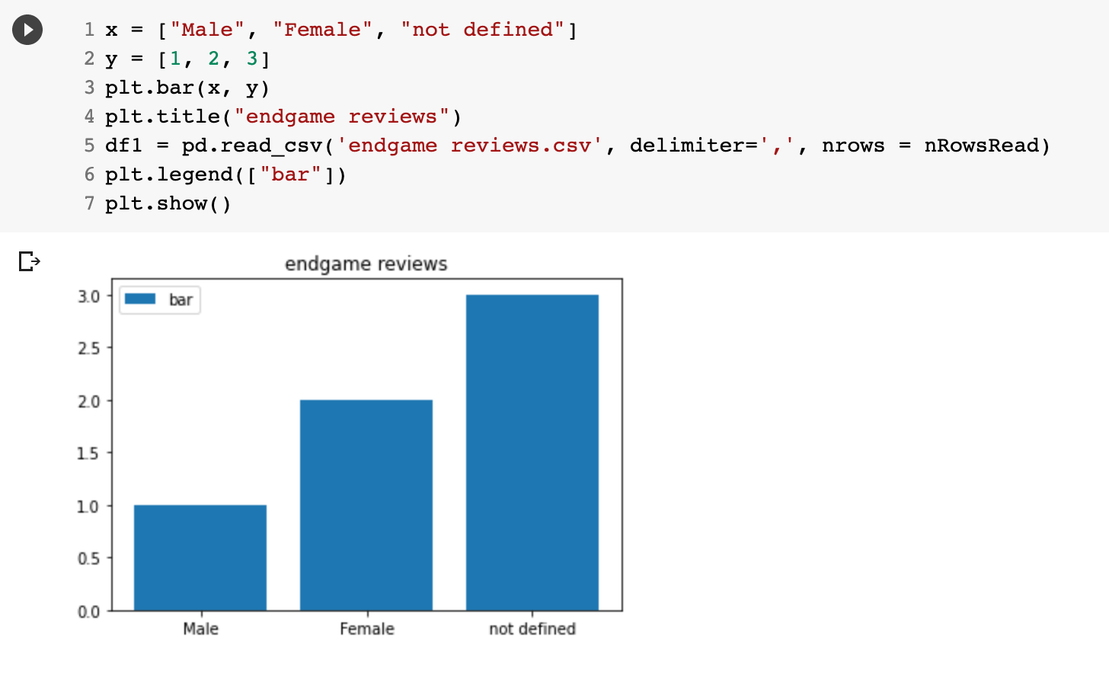
Bar Chart
This graph takes the data and totals out the average and as an output, it gives us a bar chart, in this bar chart we can see that “male” didn’t like the movie as much as the “not defined” liked it, however, the females did like it.

Slide 11
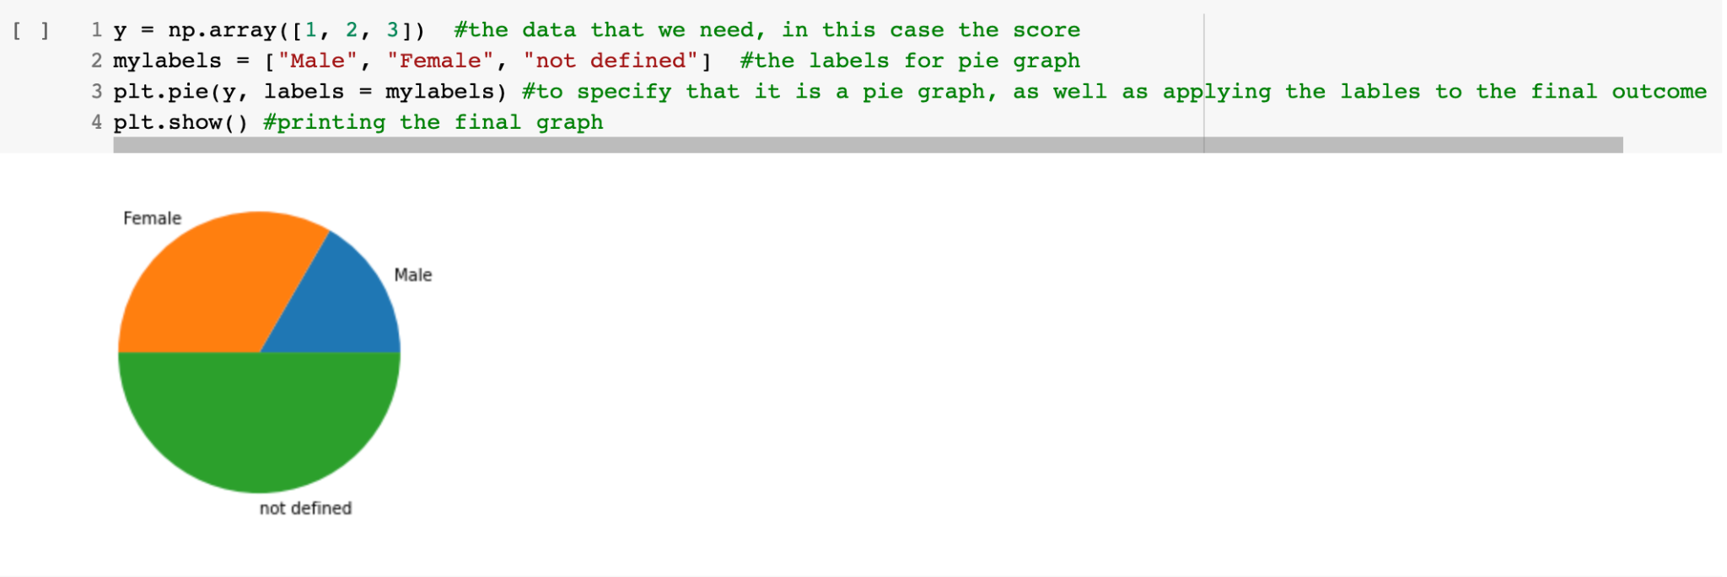
Pie Chart
The pie chart depicted here shows the percentages of various segments(gender) of audience who prefer the movie according to their likes and dislikes. As we can see “Not Defined” segment of audience have the most liking for the movie :)

Slide 12
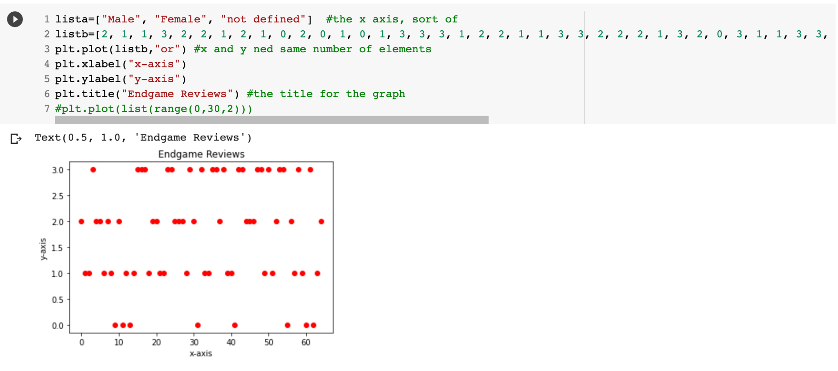
Scatter Graph
We also tried to explain our findings in the form of Scatter Graph. Because the X-axis Values were not matching with the number of Y-Axis values the graph wasn’t turning out the way we expected. But we can work upon our failure in future projects and perfect it

Slide 13
Conclusion- How will our project benefit the Film Industry?
Our projects main aim is to predict the movie reviews and identify the target audience of a certain genre of movies we chose. This can help the movie producers and directors to understand the appropriate audience and accordingly target and segment. This will increase valuable viewership of the movies which indefinitely benefits the stakeholders along with the producers of the movies.

Slide 14
